Slide 1
GROMACS
-TEAM CYPHER

Slide 2

WHAT IS GROMACS ?
GROningen MAchine for Chemical Simulations
It is free, open-source software released under the GNU General Public License (GPL).
GROMACS is one of the major software packages for the simulation of biological macromolecules
Designed for simulations of proteins, lipids, and nucleic acids.

Slide 3
WHY GROMACS ?
GROMACS is user-friendly.
GROMACS provides extremely high performance compared to all other programs.
GROMACS can be run in parallel, using either the standard MPI communication protocol, or via our own "Thread MPI" library for single-node workstations.
As the simulation is proceeding, GROMACS will continuously tell you how far it has come, and what time and date it expects to be finished.
It has excellent CUDA-based GPU acceleration on GPUs that have Nvidia compute capability >= 2.0.

Slide 4
PREREQUSITE
Get the latest version of your C and C++ compilers.
Check that you have CMake version 2.8.8 or later.
Get and unpack the latest version of the GROMACS tarball.
Make a separate build directory and change to it.
Run cmake with the path to the source as an argument
Run make, make check, and make install
Source GMXRC to get access to GROMACS

Slide 5
INSTALLATION
Sequence of steps to execute-
tar xfz gromacs-4.6.5.tar.gz
cd gromacs-4.6.5
mkdir build
cd build
cmake .. -DGMX_BUILD_OWN_FFTW=ON
make
sudo make install

Slide 6
INTEL VTune PROFILER
Intel VTune Profiler is used to analyze local and remote target systems from Windows, macOS, and Linux hosts.
Improve application and system performance through these operations:
-Analyze algorithm choices.
-Find serial and parallel code bottlenecks.
-Understand where and how your application can benefit from available hardware resources.
-Speed up the execution of your application.

Slide 7
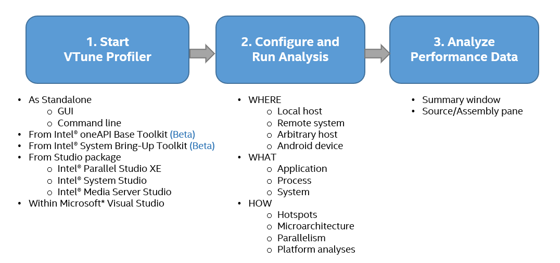
Work flow of Profiler

Slide 8
INTEL TRACE ANALYZER AND COLLECTOR
It helps you:
Find temporal dependencies and bottlenecks in your code
Check the correctness of your application
Locate potential programming errors, buffer overlaps, and deadlocks
Visualize and understand parallel application behavior
Evaluate profiling statistics and load balancing
Analyze performance of subroutines or code blocks
Learn about communication patterns, parameters, and performance data
Identify communication hot spots
Decrease time to solution and increase application efficiency

Slide 9
MPI Checking
A unique correctness checker does the following:
Detects deadlocks, data corruption, and errors with MPI parameters, data types, buffers, communicators, point-to-point messages, and collective operations
Able to scale to extremely large systems and detect errors among a large number of processes

Slide 10
Scalability
Low overhead allows random access to portions of a trace, making it suitable for analyzing large amounts of performance data.
Thread safety allows you to trace multithreaded MPI applications for event-based tracing and non-MPI threaded applications

Slide 11
Instrumentation & Tracing
Low-intrusion instrumentation supports MPI applications with C, C++, Fortran, or OpenSHMEM
Performance data from parallel threads in C, C++, Fortran, and OpenSHMEM is automatically recorded

Slide 12
THANKS!
Any questions?

